Slide 1
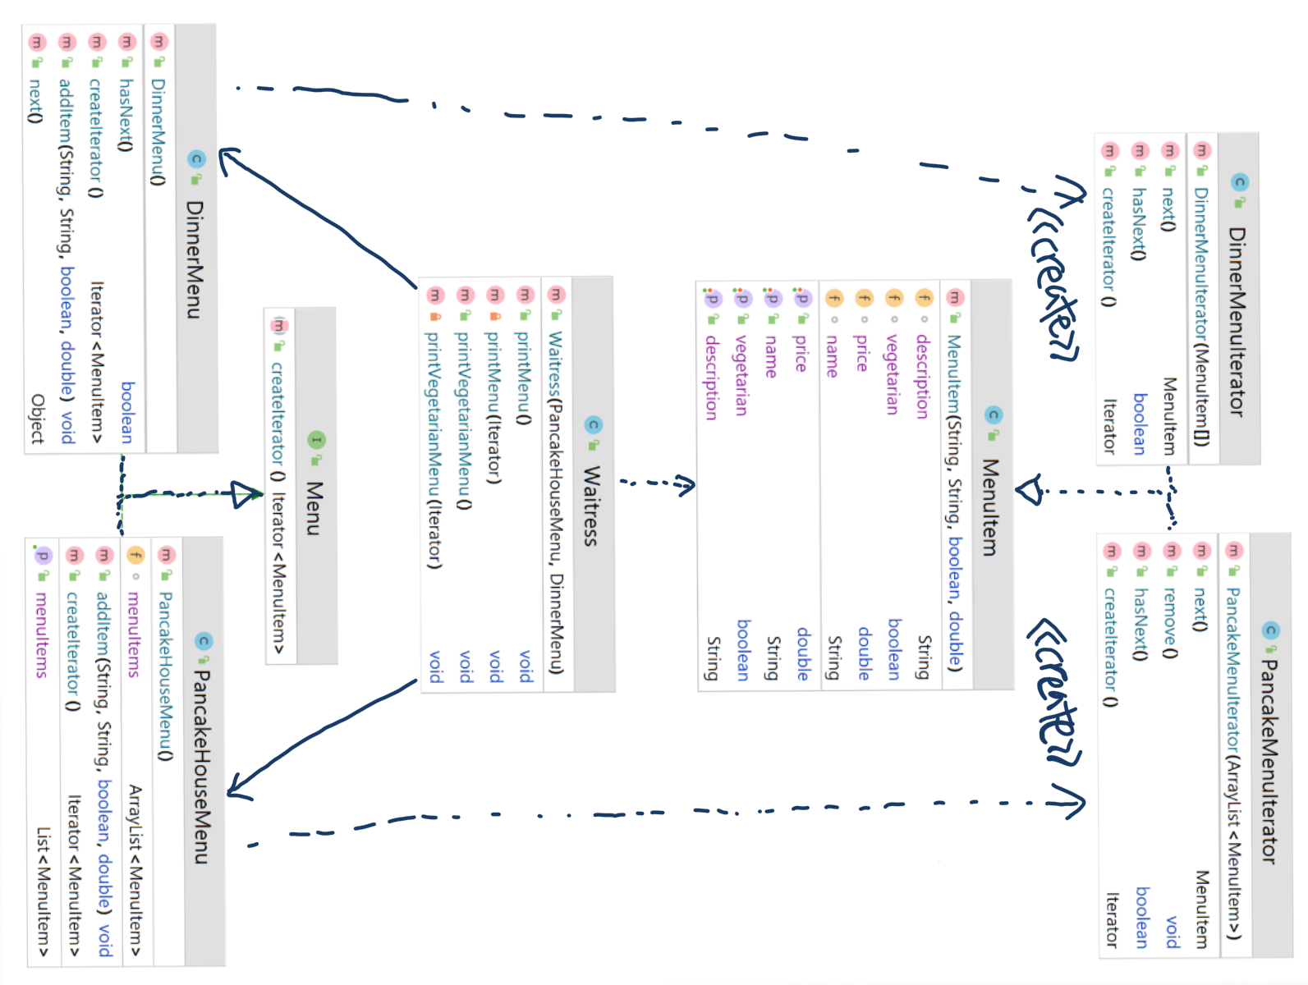
Concrete Iterator
Aggregate
Concrete Aggregate
Concrete Iterator
Iterator

Slide 2
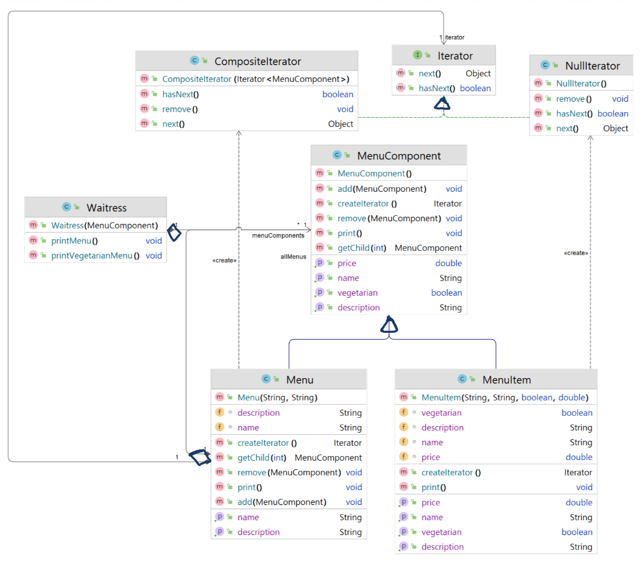
Component
Composite
Leaf

